Slide 1
COMM 2293:
Business Communications
Section F
Prof. Emily Ballantyne
12 February 2019 – Assignment 3 Workshop

Slide 2
Agenda
Modifiers
Midterm Preview
Workshop

Slide 3

Today is a Workshop day.

Slide 4

Modifiers

Slide 5
Modifiers
Incorrect:
As a business professional, my messages should be clean, clear and precise.
Correct:
As a business professional, I should write clean, clear, and precise messages.

Slide 6
Modifiers: Which is correct?
1) Prof. Ballantyne gave an example to the student that was short.
OR
2) Prof. Ballantyne gave an example that was short to the student.

Slide 7
Modifiers: Which is correct?
1) The student selected an answer that was wrong in the quiz.
OR
2) The student selected an answer in the quiz that was wrong.

Slide 8
Midterm Preview
COMM 2293

Slide 9
Midterm Details
When:
  In-class, Tuesday, February 26
Where: In class
Please bring your student ID.

Slide 10
What you will be asked to do for the midterm
Write two routine messages (claim and adjustment).
Answer short questions related to the prewriting stage.
Label and write an introduction to a graphic.
Answer a short question about graphics.

Slide 11
Studying Strategies
Review textbook, course pack, class notes & slides
Go over previous assignments—remind yourself what you did well, and what needed improvement
Answer the review questions at the end of the chapters we’ve studied.

Slide 12
Assignment 3 Workshop
COMM 2293

Slide 13
Get prepared.
Move desks into
groups of four
Take an assigned
number
Move to your assigned group
Give your paper to the person on your right.
Reminder: do not take any pictures or copy any parts of someone else’s assignment

Slide 14
Get started.
Look at the assignment in front of you. Does it have four distinct paragraphs?
If not, write “Follow four-part AIDA strategy” at the top of the page.

Slide 15
Fold your paper into four based on the paragraphs. Read just the first paragraph.
1
2
3
4

Slide 16
First Paragraph: Attention
Does the subject grab your attention without giving away the request?

Slide 17
First paragraph: Attention
Does the subject grab your attention without giving away the request?
The Opening paragraph (Attention) should be a brief attention-getting fact, statistic, or question that doesn’t give away request.

Slide 18
First paragraph: Attention
How does the author get the reader’s attention?
  Use a fact or statistic
  Say something surprising
  Ask a question (that can’t be answered with a simple yes or no)
Is it effective? Is it a good way to get your boss’s attention? Did it grab your attention?
  Is it written with the ‘you’ view in mind?
  Can you recommend a better way to grab the reader’s attention?

Slide 19
First paragraph: Attention
Opening paragraph should be no more than two sentences.
Write “Too long” if it’s more than two sentences)

Slide 20
First paragraph: Attention
Opening paragraph should be no more than two sentences.
Write “Too long” if it’s more than two sentences)

Slide 21
Fold down the first paragraph. Pass the paper to the right. Read just the second paragraph.
1
2
3
4

Slide 22
Second Paragraph: Interest
How does the writer build interest?
  If the opening asked a question, does this paragraph answer that question?

Slide 23
Second Paragraph: Interest
  Does the paragraph:
    Use statistical information to help you to explain why this is an important issue in which the reader should be interested?
    Use specific evidence to avoid vague, generalized, and unsubstantiated statements?
    Present the issue as a problem that getting rid of plastic bags could solve?

Slide 24
Second Paragraph: Interest
  Are all of the facts customized to meet the specific information needs and concerns of Mr. Patel?

Slide 25
Second Paragraph: Interest
  Are all of the facts introduced with a signal phrase? (e.g. According to Ballantyne…)
  Underline any signal phrases in this section.
  If there are no signal phrases, circle the fact and write “signal phrase?” or “what is the source?”

Slide 26
Pass the paper to the right. Skim the end of the second paragraph and the beginning of the third paragraph.
1
2
3
4

Slide 27
End of Second/Beginning of Third Paragraph: Subject Request
Circle the sentence that clearly states the subject/makes a request.
Is it positioned at the end of the second section or the beginning of the third?
  If so, place a checkmark beside the circle
  If not, place an X beside the circle
  If it’s missing, write “Request Missing” in the margin

Slide 28
Keep your paper. Fold down the second paragraph. Read the third paragraph.
1
2
3
4

Slide 29
Third Paragraph: Desire
Does this paragraph:
  Outline the benefits of the action?
  Acknowledge reader’s resistance and offer a counter argument to reduce that resistance?
  Tailor all reader benefits and counter-arguments to meet the specific information needs and concerns of Mr. Patel?

Slide 30
Third Paragraph: Desire
Underline each signal phrase
If there are no signal phrases, circle the fact and write “signal phrase?” or “what is the source?”
Put a star (*) beside the sentence(s) that reduces resistance.

Slide 31
Fold down the third paragraph. Pass the paper to the right. Read just the fourth paragraph.
1
2
3
4

Slide 32
Fourth Paragraph: Action
Does this paragraph:
  Restate the request?
  Get the reader to take action by suggesting a concrete first step?
  Tell the reader how to contact the writer without making demands?
  Build goodwill by personalizing the message?

Slide 33
Fourth Paragraph: Action
Double-underline the action statement.
  Is the action clear?
  Is it easy to follow?
Does the sentence focus on an action and not a timeframe?

Slide 34
Open up the paper and return it to its author.

Slide 35
Formatting Self-Check
Do you use correct memo format (four-part header, no greeting, omits a closing and signature, etc.)?
Do you use full-block format, single-spaced, readable 11- or 12-point font, and a ragged right margin
Is your message one page (without shrinking print size or margins)
Avoid APA-style page citations and reference list?
Avoid cliché, stereotypical business-speak, and tired expressions?

Slide 36
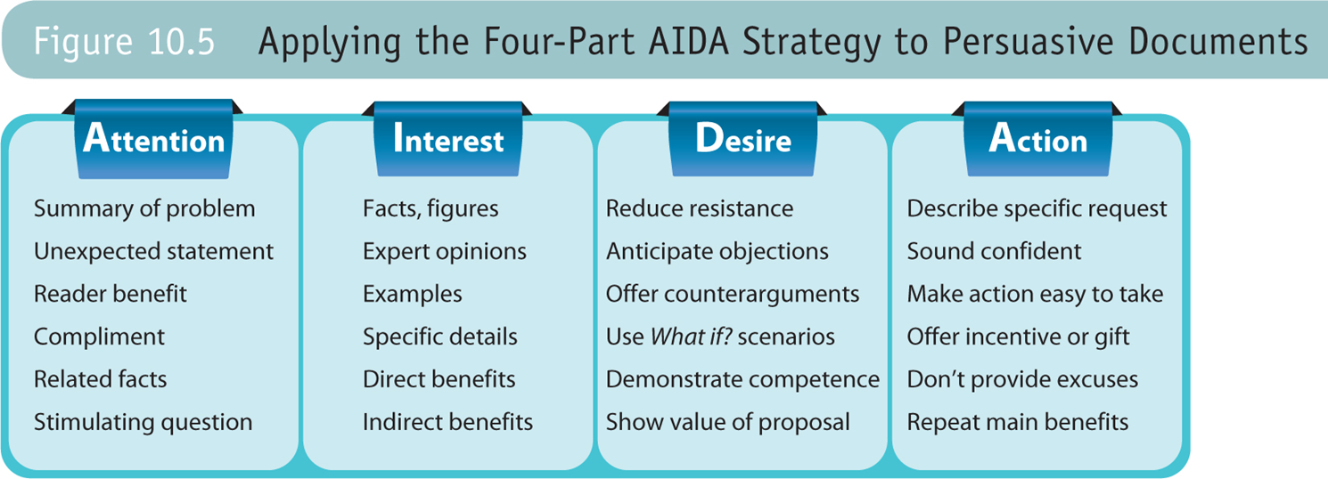
Reflection: How will I revise?
Remember: you are ultimately responsible for revising your assignment. You have to decide what suggestions to accept and which to reject.
When revising your assignment, consider your workshop feedback, and the assignment 3 checklist.
Review Figure 10.5 to check the content of each paragraph.

Slide 37
For Thursday
Midterm Preparation
Review: Direct strategy
Graphics
Assignment 1 & 2
Feedback on all assignments

